Slide 1
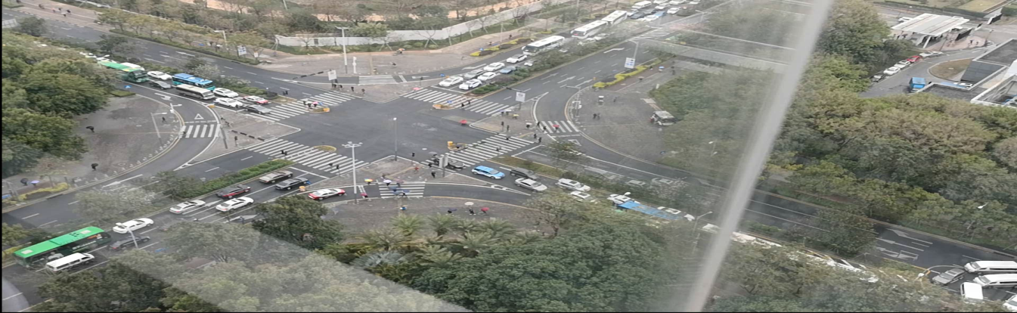
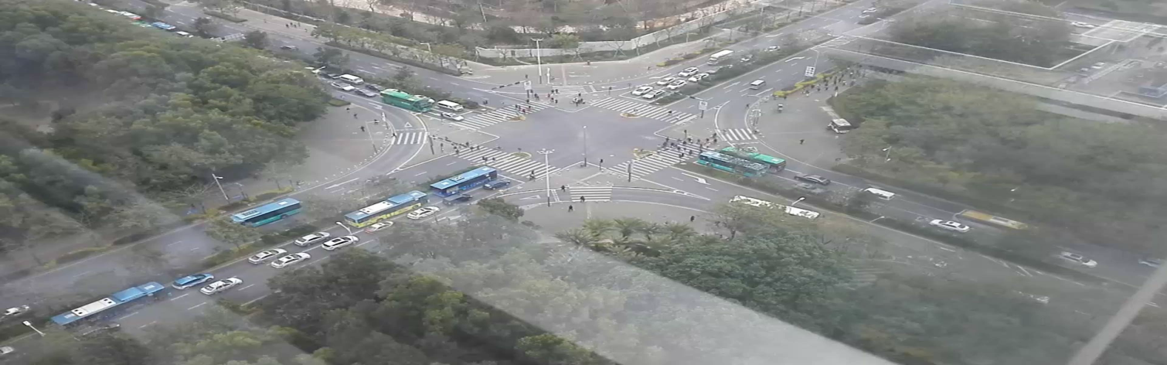
Smart Traffic Control: A New Way to Time Traffic Lights for Smoother Traffic Flows
Before: Drivers count the time before lights change.
After: Traffic lights count cars, then change.
Traffic signals change before the straight-ahead lane is empty, causing congestion.
Traffic signals change after the straight-ahead lane is empty, ensuring smooth movement.
Traffic diagnosis and judgment
Average delay
Average vehicle speed
Waiting vehicles at a signalized intersection
Pedestrian traffic
OD analysis
Traffic light regional coordination
17.7%
15%
Real-time vehicle traffic
Vehicle directions
Traffic load distribution (by time segment or area)
Commuter density

Slide 2
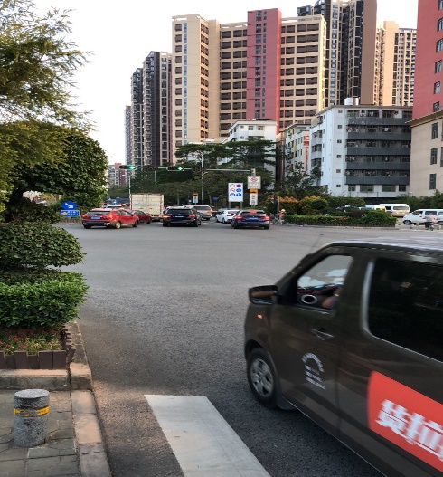
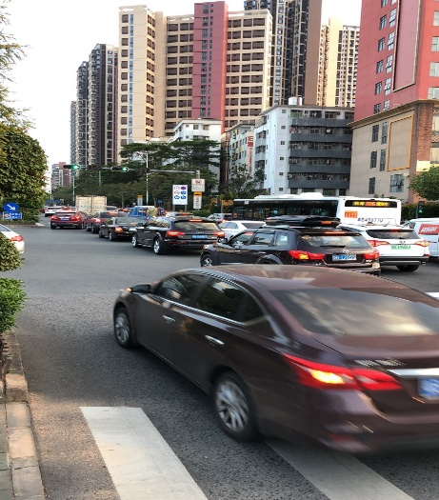
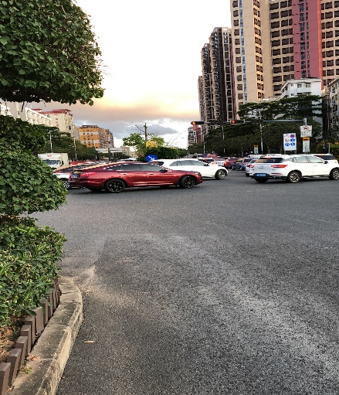
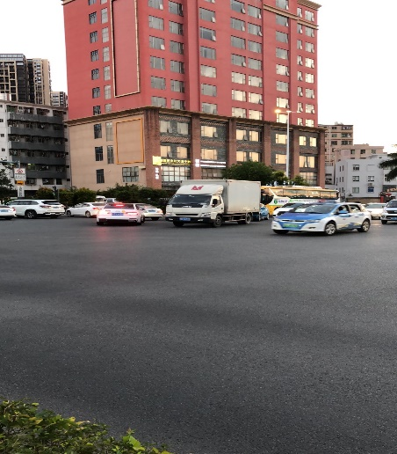
Smart Traffic Control: Phase Sequence Optimization Alleviates Intersection Congestion
In April 2020, construction was taking place at the southbound section of the Wuhe Avenue & Beier Road intersection and caused traffic congestion. TrafficGo provided suggestions on phase sequence optimization to alleviate congestion.
East-south phase followed by north-south phase
The sequence of these two phases were switched.
South
South
East
North
Vehicles were not cleared when the east-south phase ended.
The road was blocked when the north-south phase began.
Phase sequence optimization eliminates intersection congestion.
Problem: The left-turn traffic from east to south was heavy, which led to intersection overflow. After the phase ended, the north-south straight-ahead phase immediately began. This made the congestion even worse. The queue overflowed up to Wuhe Avenue & Beier Road intersection.
Pain point: Even with manual traffic control during peak hours, the congestion of the east-south direction cannot be avoided.
Effect: The AI diagnosis model comprehensively analyzed the traffic flows and control solutions in all intersections and decided to switch the sequence of two phases.
Flexible manual traffic control: A transition phase was put between the east-south left-turn phase and the north-south straight-ahead phase. The east-south left-turn traffic can be cleared before the north-south phase begins.

Slide 3
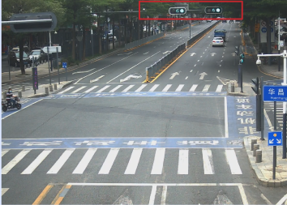
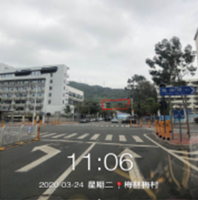
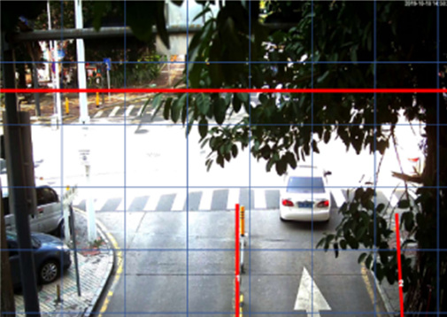
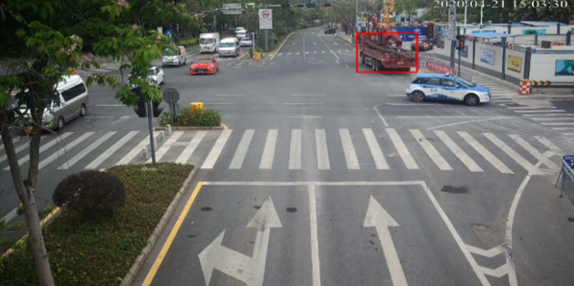
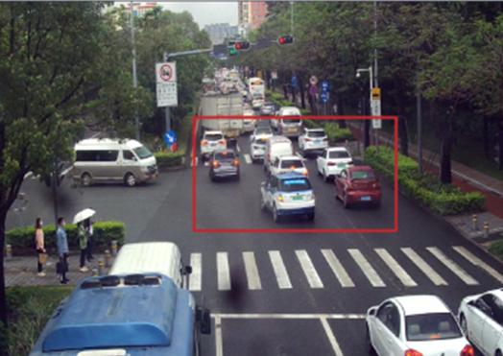
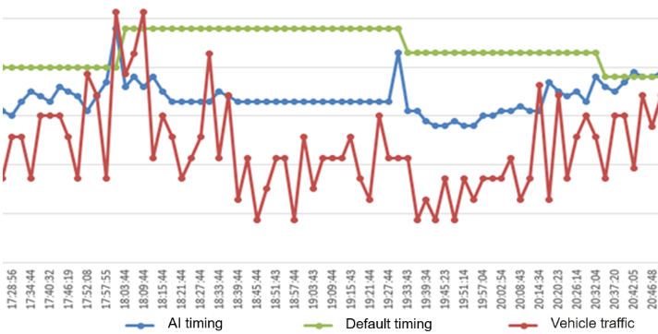
Smart Traffic Event Detection: 35 Events per Day, 90% Accuracy
TrafficGo monitors events by analyzing collected videos in real time and generates warnings once problems are detected.
Real-time faulty signal detection
Real-time detection of abnormal parking
AI-powered remote detection
Quick identification of abnormal parking with vehicle detection and object tracking techniques
Event logs
Timing plan
Video snapshots
Improper traffic light timing
Zero traffic lights
Trees blocking traffic lights
Real-time detection of queue overflow at intersections and major congestion points
Real-time detection of unnecessary green lights, improving road efficiency
O&M solution
Automatic identification of traffic running status at intersections and prompt intervention to eliminate large-scale congestion
Quick identification of unnecessary green lights by comparing signal light status and traffic flows
SMS alerts
AI-powered remote detection

Slide 4
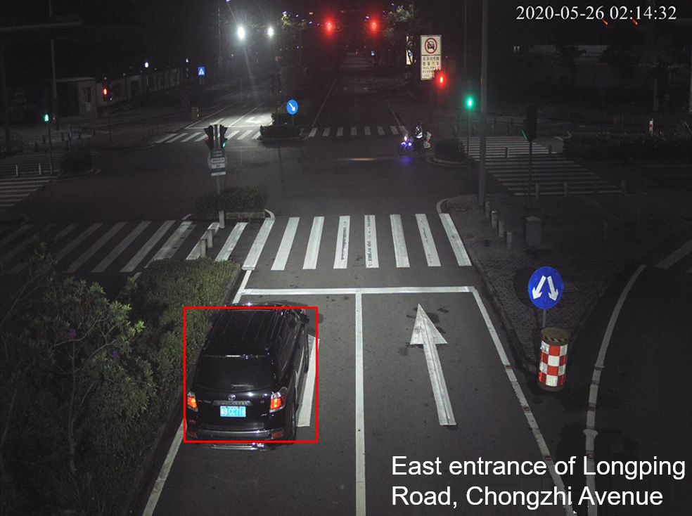
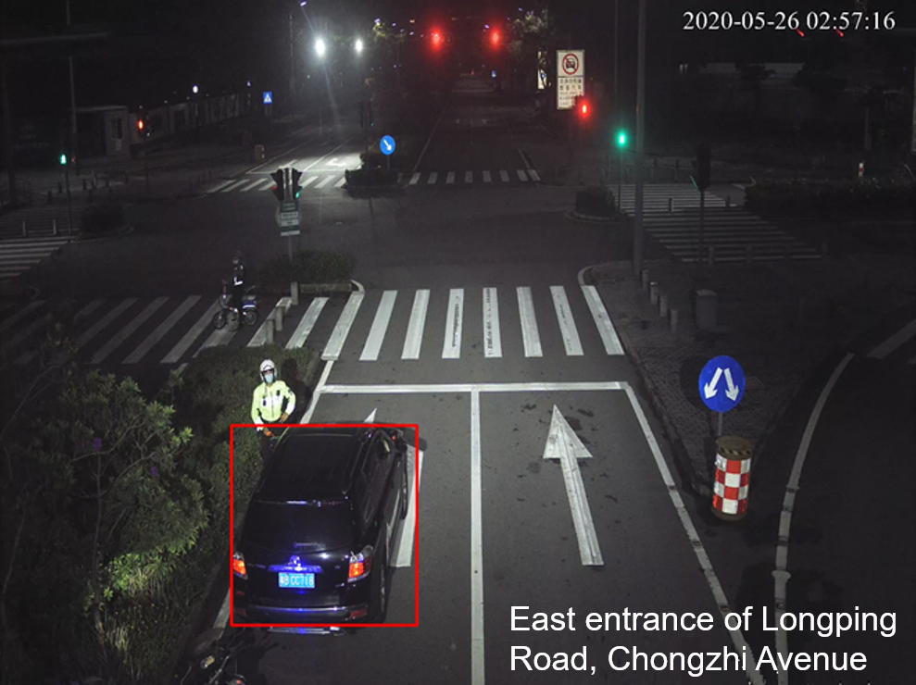
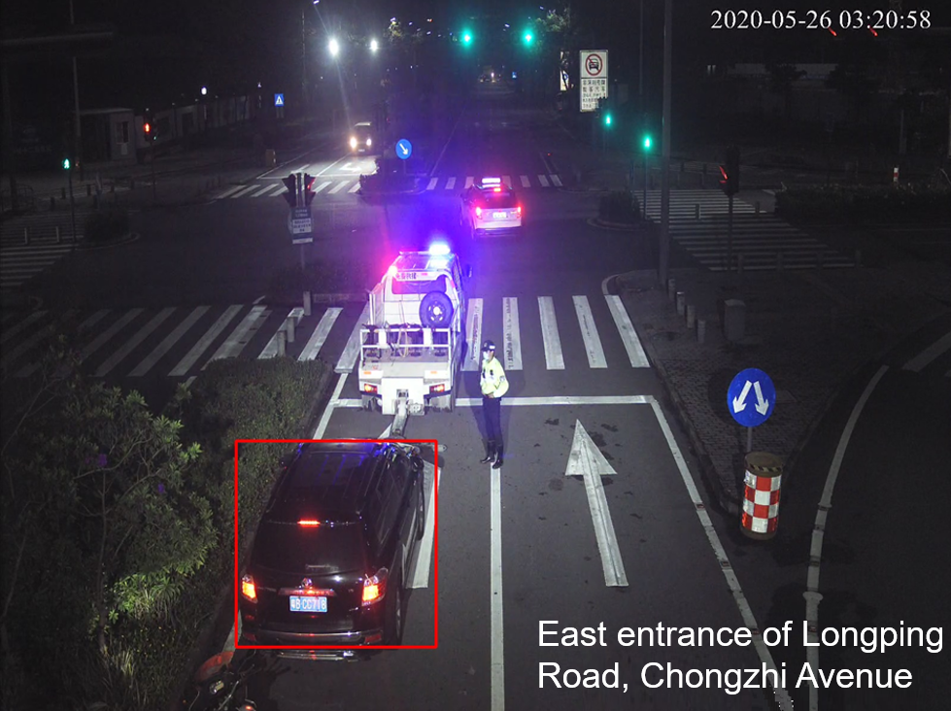
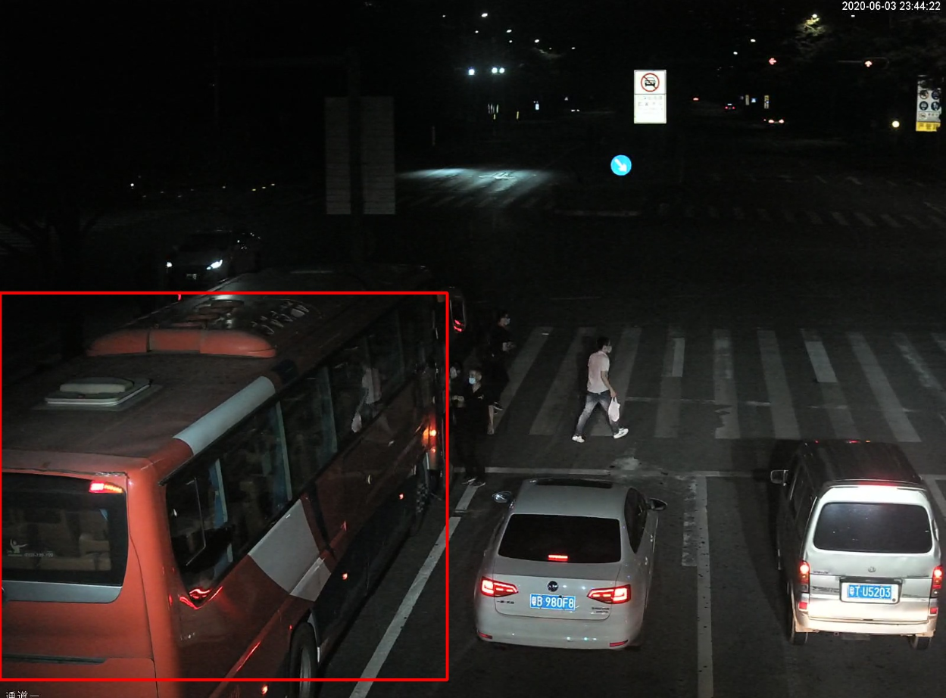
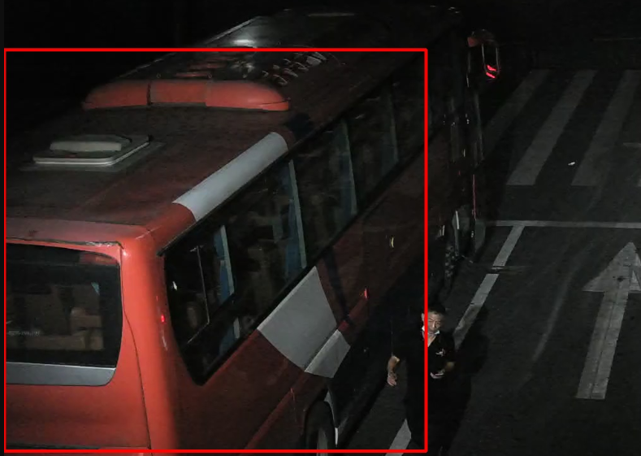
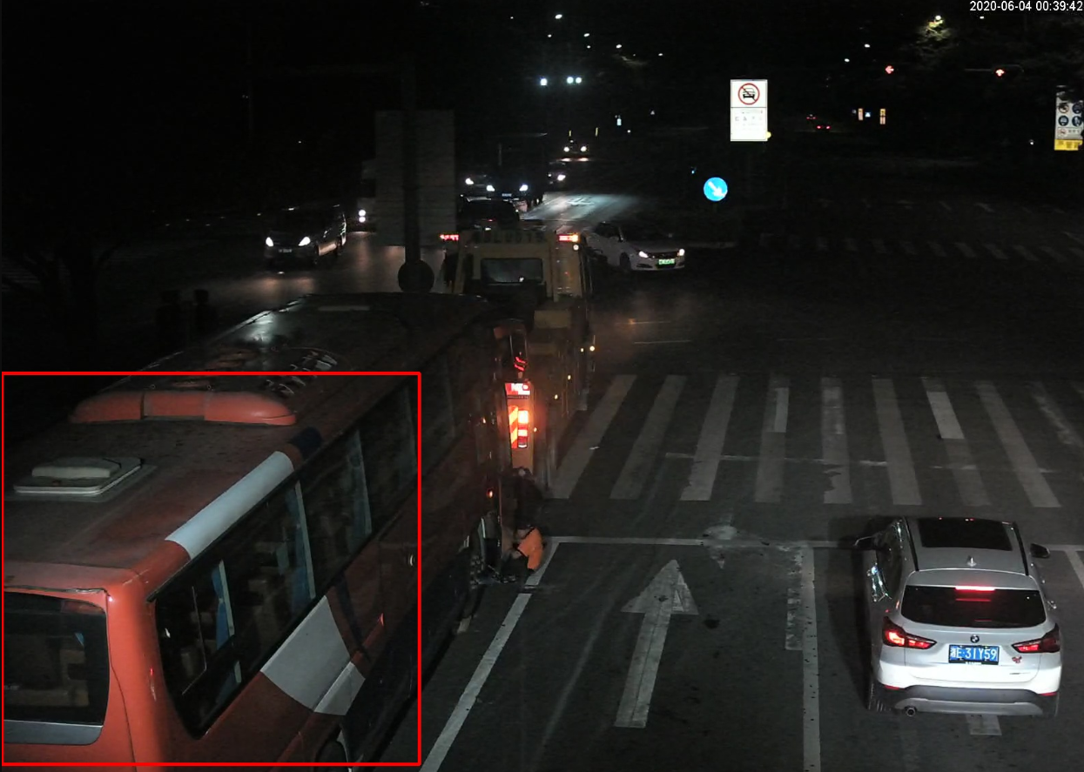
Smart Traffic Event Detection: Prompt Detection Helps Reduce Road Risks
Case 1: A vehicle stopped in one lane for more than one hour at the east entrance of Longping Road, Chongzhi Avenue on May 26, 2020.
An abnormal parking event occurred at 02:14.
The traffic police arrived after 02:56.
The tow truck arrived at 03:20.
Case 2: On June 3, 2020, a bus occupied one lane for one hour at the north entrance of Zhang Heng Road, Wuhe Avenue.
The vehicle broke down at 23:45.
The driver tried to repair the engine but failed and called the tow truck at 23:58.

Slide 5
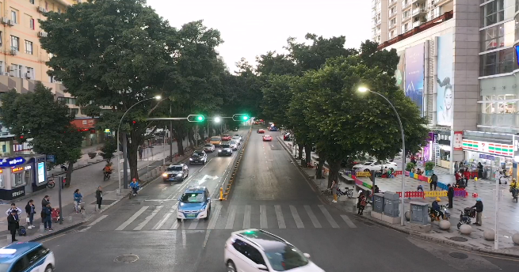
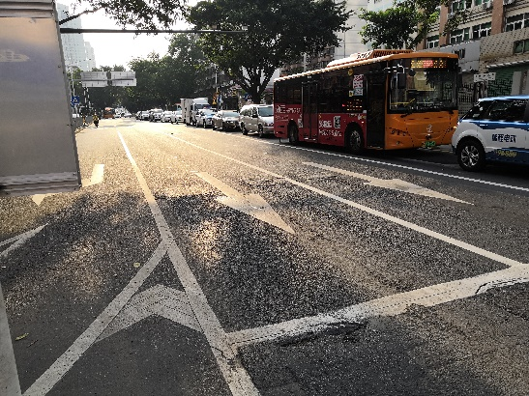
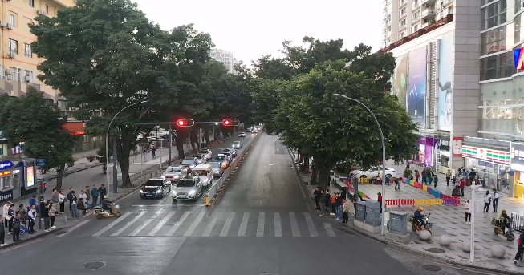
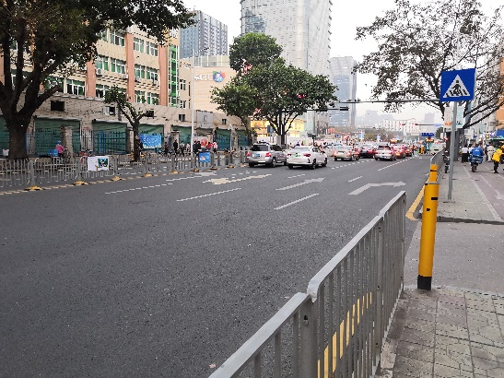
Smart Traffic Diagnosis: Shenzhen's Meilin Subdistrict Reduces Congestion by 12% Through Phase Splitting
City-wide traffic diagnosis, from manual observation to automatic detection from data
Covered 80 of 700 intersections with heavy traffic, spanning four districts of Shenzhen.
Diagnosis results indicate that no exception occurred at most intersections. Two phase sequence problems in Meilin Road and one marking line problem in Bantian Road were discovered.
Meihua Road-Meicun Road Traffic Diagnosis
Meilin Road-Zhongkang Road Traffic Diagnosis
Diagnosis object: west entrance of the Meilin Road-Zhongkang Road intersection
Diagnosis result: space allocation is not suitable and ROW allocation does not match traffic flows.
Cause: The left-turn traffic entering the Zhuo Yuehui business district is heavy. The left-turn lanes are crowded during peak hours.
Suggestion: Convert a straight lane into a straight-left turn hybrid lane.
Diagnosis object: Meihua Road-Meicun Road and Meihua Road-Zhongkang Road
Diagnosis result: Signal timing is not suitable, and the lights staying green for a long time impacts efficiency.
Cause: The road at the western entrance is narrow (two lanes) with heavy traffic and the green light lasts for 90 seconds during peak hours.
Suggestion: Split the long green light to keep traffic flowing.
Before
Before
After
After

Slide 6
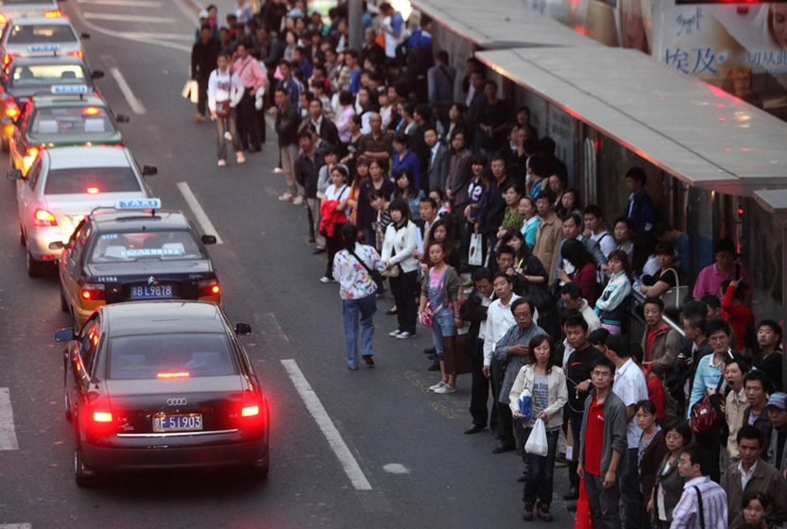
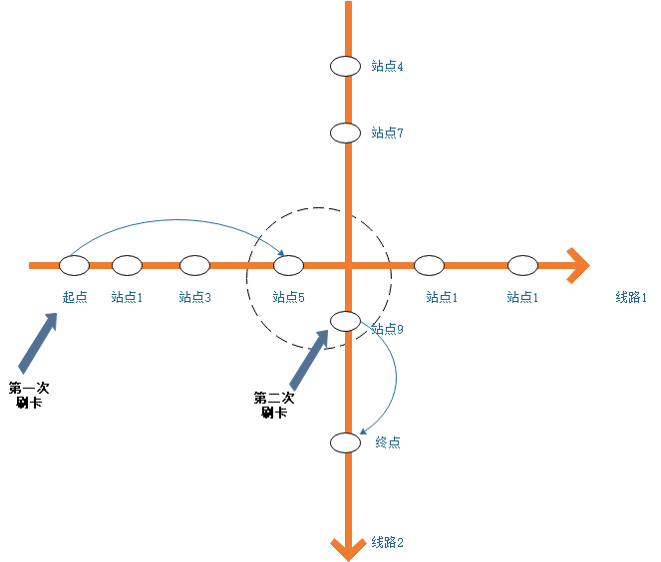
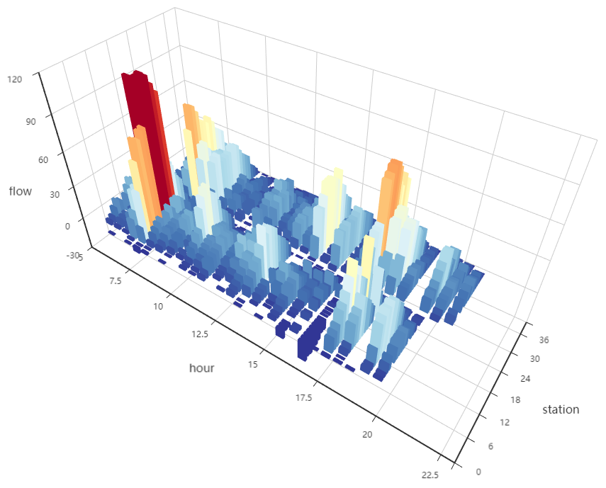
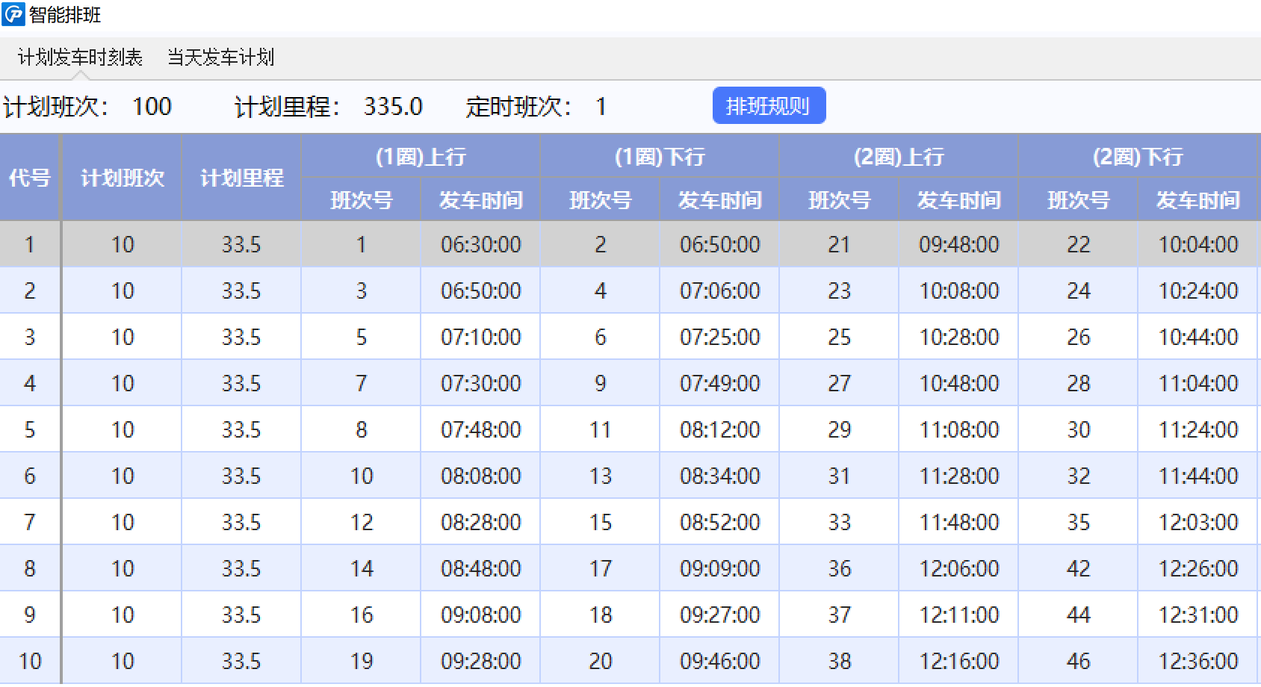
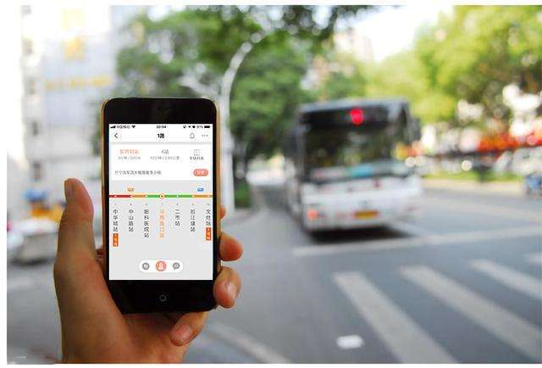
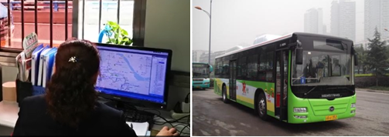
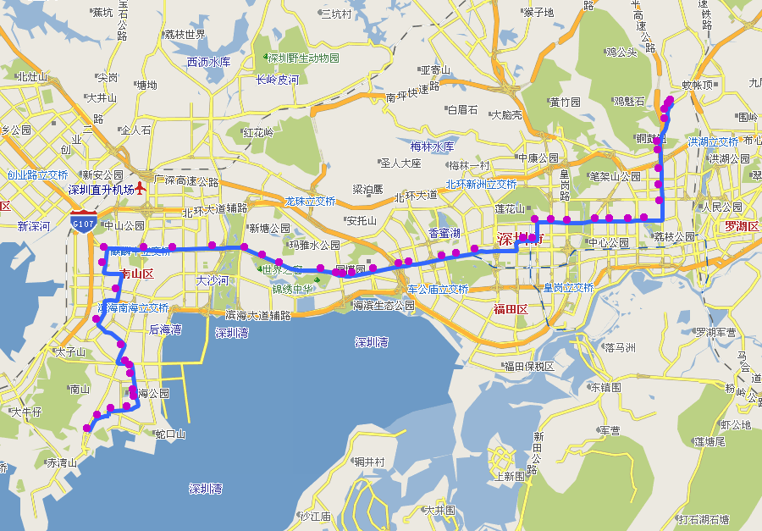
Smart Bus Scheduling: Shenzhen Bus Group Improves Operations Efficiency
Precise bus scheduling
Bus traffic
Smart scheduling
Route and network optimization
Bus scheduling
Collaborative optimization of bus and rail stations
External factors
Application
scenario
Traveling
Passenger traffic
Secure, convenient, and comfortable
traveling
Low punctuality rate, long time on road, and uncomfortable experience
Before traveling
Waiting
Finish traveling
Convenient
information query and flexible route planning
Bus arrival prediction
Efficient transfer to rail
Internal factors
Passenger traffic OD analysis
Passenger traffic prediction and warning
Bus timetable development
Bus arrival time prediction
Dynamic adjustment
Driver scheduling
Experience-based scheduling,
inaccurate bus scheduling,
and improper route planning
5–10%
90%
1 hour 3 seconds
6 hours 10 minutes
Travel time
Bus punctuality rate
Bus timetable development
Driver scheduling

Slide 7

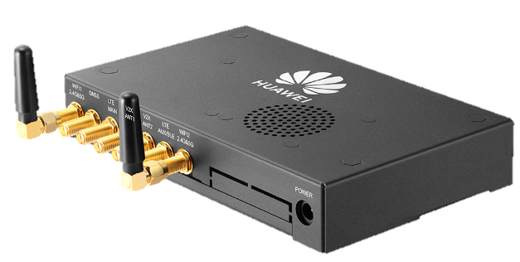

Smart Bus Scheduling: Dadong Smart Bus Project Ensures Bus Punctuality
Dadong District is an important automotive manufacturing hub in Shenyang, with four major automotive manufacturers and their parts suppliers, covering five brands (BMW Brilliance, GM Buick, GM Chevrolet, Renault Jinbei, and Brilliance) and 17 vehicle types. The Dadong Smart Bus project implements vehicle-road synergy using Huawei Cloud TrafficGo, making public buses as punctual as high-speed railways.
Pain points
Precision bus solution
Unpleasant experience: Passengers need to wait for an average of 20 minutes for their buses because bus arrival prediction is not accurate.
Huawei Cloud
Traffic police platform
Low utilization: Buses depart at random, and are sometimes oversupplied.
Bus operations
scheduling system
High security risks: Old urban areas are not completely covered by monitoring cameras, and accidents are 14 times more likely to occur in extreme weather conditions, such as rain, fog, and snow.
Fiber/Uu
Uu
PC5
OBU
RSU
Roadside sensing
Precise bus arrival prediction based on C-V2X vehicle-road synergy and interaction mechanism of proactive real-time priority policy with low cost and high precision
Real-time bus scheduling based on AI (PID algorithm) and mathematical planning, automatically generating and releasing bus arrival timetables
Roadside communication
All-domain sensing for 200 traffic accident types and targeted accident report based on the accident location and impact scope
Traffic signal
controller

Slide 8
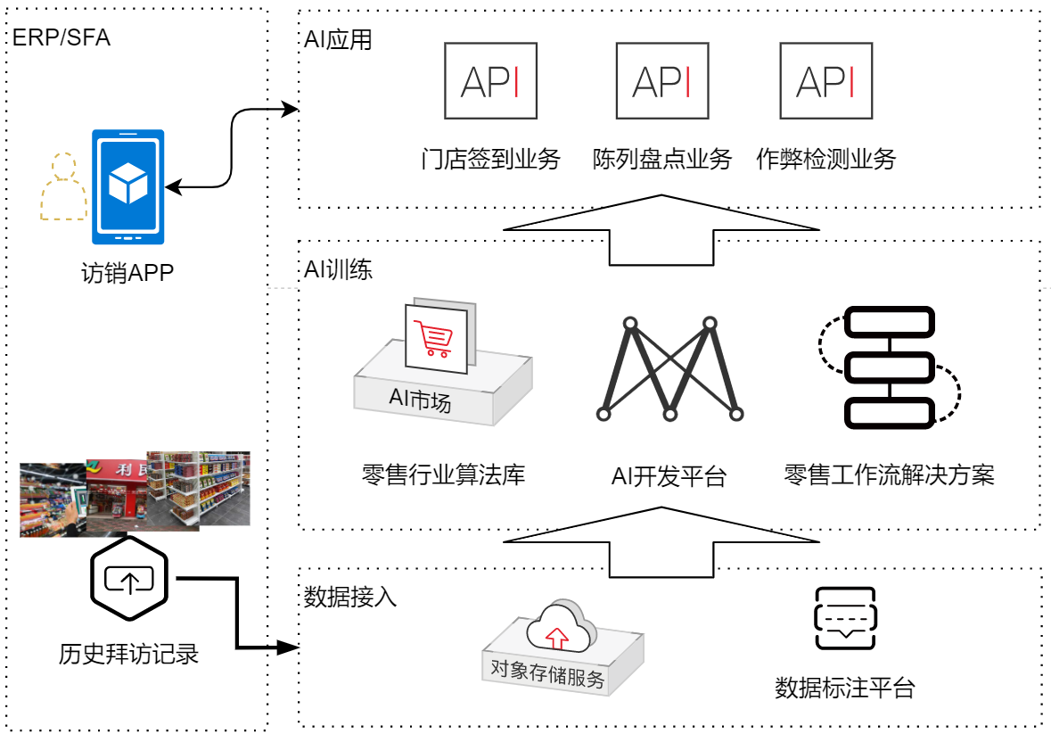
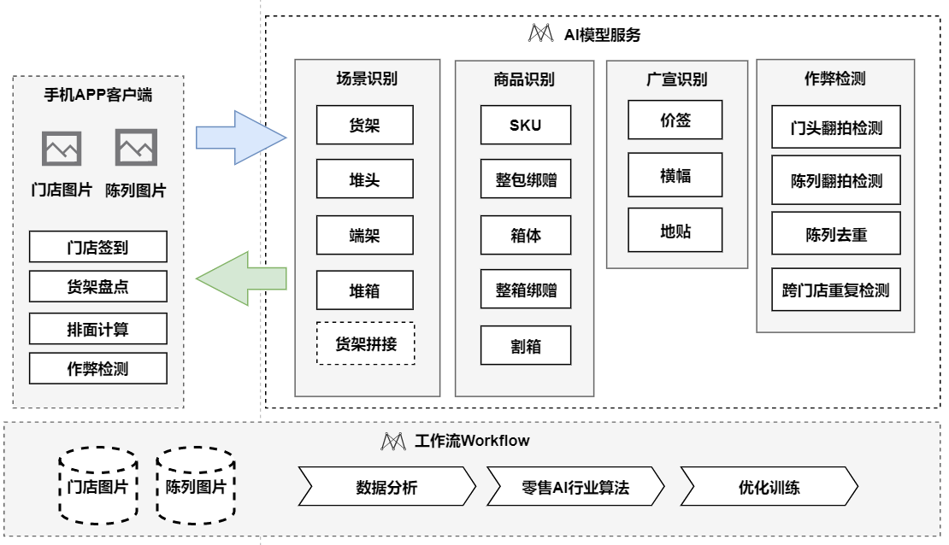
AI-supported Shop Inspection
Solution introduction
Cloud service architecture
Service scenario: AI-powered shop inspection smartly completes device access services such as store sign-in, stocktaking of shelves and displays, widespread marketing identification, and fraud detection, implementing a digital system for in-depth enterprise distribution.
Customer benefits: A more efficient, convenient, accurate, and comprehensive AI store inspection solution helps the digital transformation of the retail industry, which greatly reduces labor costs and improves work efficiency. This enables precise product stocktaking and satisfying publicity effect, capturing high-quality markets.
AI applications
Store sign-in
Display stocktaking
Fraud detection
Sales app
AI training
Solution architecture
AI Gallery
Objective: In the retail industry, enterprises visit offline stores to gain insight into store opening, display, image, and activities, as the basis of marketing decision-making. This ensures good product display and advertising effects. Retail enterprises hope to use intelligent store inspection to improve the store inspection efficiency and quality, and standardize the operations of stores across the country.
Retail industry algorithm library
AI development platform
Retail workflow solutions
Data ingestion
Historical visit records
OBS
Data labeling platform
AI model service
Mobile app client
Scenario recognition
Product identification
Widespread marketing identification
Fraud detection
Advantages
Shelf
SKU
Price tag
Storefront recapturing detection
Stack
Few packs as a package
Banner
Display recapturing detection
Store sign-in
Large-model image matching algorithm, better adaptability to blocked storefront, no plaque, and multi-storefront
Store images
Display images
Store sign-in
Endcap
Box
Ground label
Display duplication
Stocktaking of shelves
Stacking box
A box as a package
Cross-store duplication detection
Accurate SKU location information (shelf, stack, and endcap) and differentiated processing
High recognition rate for even tilted shelves
Quick update and rollout of new product SKUs in minutes
Calculation of products stacked in the front of the display on a shelf layer
Image and SKU matching for effective deduplication
Product arrangement
Display stocktaking
Fraud detection
Shelf splicing
Die-cut box
Workflow
Store images
Display images
Data analysis
AI algorithms in retail
Optimization training
Fraud detection
Recapture detection (night shot effects better than those of competitors)
Duplication detection and cross-store image detection

Slide 9


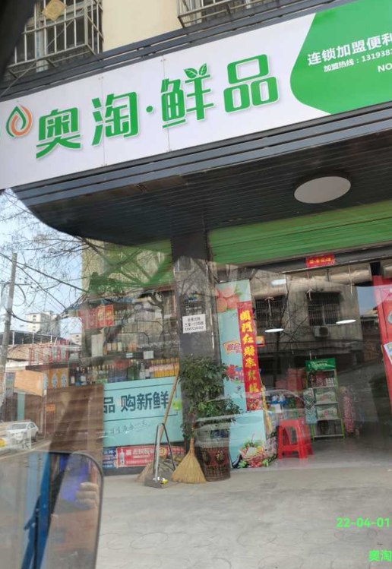
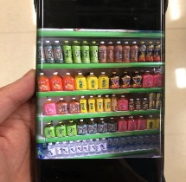
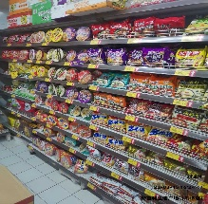
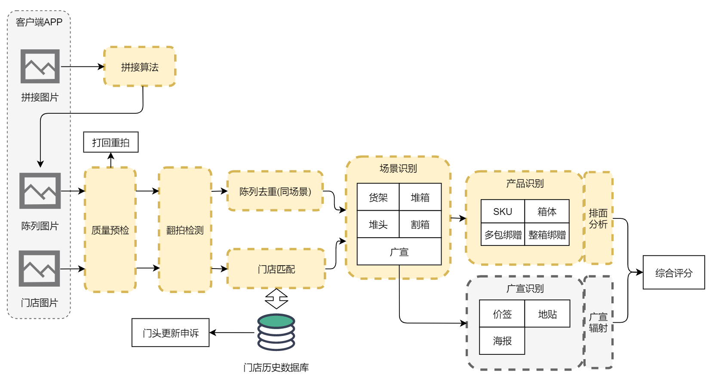

Case Study for AI-supported Shop Inspection: Baixiang Food
Founded in 1997, Baixiang Food Co., Ltd. is a comprehensive food enterprise mainly producing and selling high-quality flour products. Since 2003, it has maintained a market share of about 18%, ranking among the top in the Chinese market. At present, Baixiang Group has hundreds of products and nearly 1.2 million sales terminals, covering 30 provinces, cities, and autonomous regions in China. Parts of products are sold overseas.
AS IS
TO BE
Store sign-in matching
Detection into recapture and duplication
Stocktaking of shelves and displays
High labor costs
50+ reviewers are needed to final check the SKUs each year, and thousands of salespersons are needed to take photos offline and manually enter SKU data.
Low efficiency
It usually takes several working days for reviewers to review the photos taken by salespersons.
Low accuracy and inconsistent standards
The standards of offline system vary by region in each province, which is hard to unify.
Falsification out of control
Salespersons may not go to the specified stored to take pictures, and they may go to another one instead.
Falsified data leading to a wrong decision
The reviewers fail to update the complete data after the data is reviewed, which delays the overall data analysis.
App client
Labor costs: 50%↓
Stitching algorithm
Stitched images
Millions of stores
Matching rate: 90%+
Identification rate: 93%+
SKUs: 500+
Identification rate: 92%+
Rejected
Inspection efficiency: 3x ↑
Scenario identification
Display duplication
Shelf
Stacking
box
Product identification
Arrangement analysis
Display images
Quality pre-check
Recapture detection
Stack
Die-cut box
SKU
Box
Several packs as a package
A box as a package
Widespread marketing
Store matching
Comprehensive score
Widespread marketing identification
Widespread marketing
Store images
Ground label
Price tag
Store change appeal
Poster
Store historical database

Slide 10
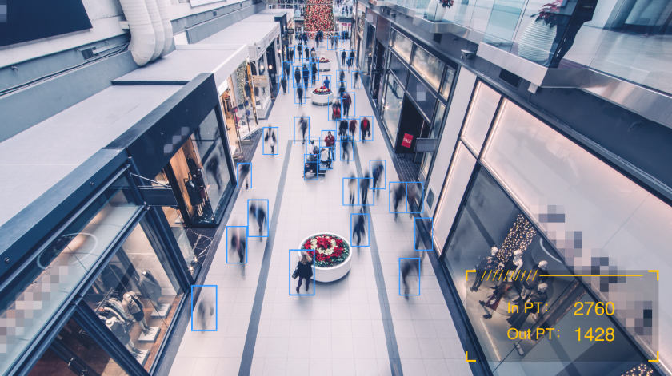
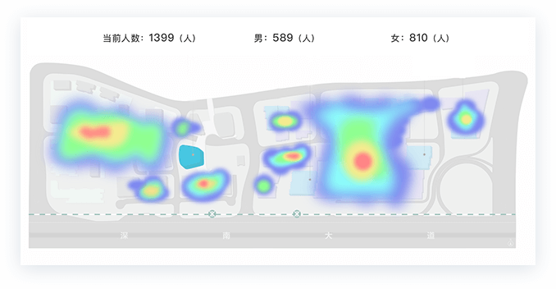
Smart Store: Customer Flow Statistics
Solution: Cameras in retail stores collect videos. The AI-powered video analysis algorithm accurately measures customer flows of stores through facial recognition and head-shoulder detection.
Multiple areas can be specified for monitoring and customer flow counting.
Crowd heat map is drawn based on persons' trajectory. This helps master the hotspot areas with high customer density and improve customer experience and sales efficiency.
Algorithms can be deployed on the edge and on end devices, keeping data on premises and ensuring data security.
Number of people: 1399
Man: 589
Woman: 810

Slide 11
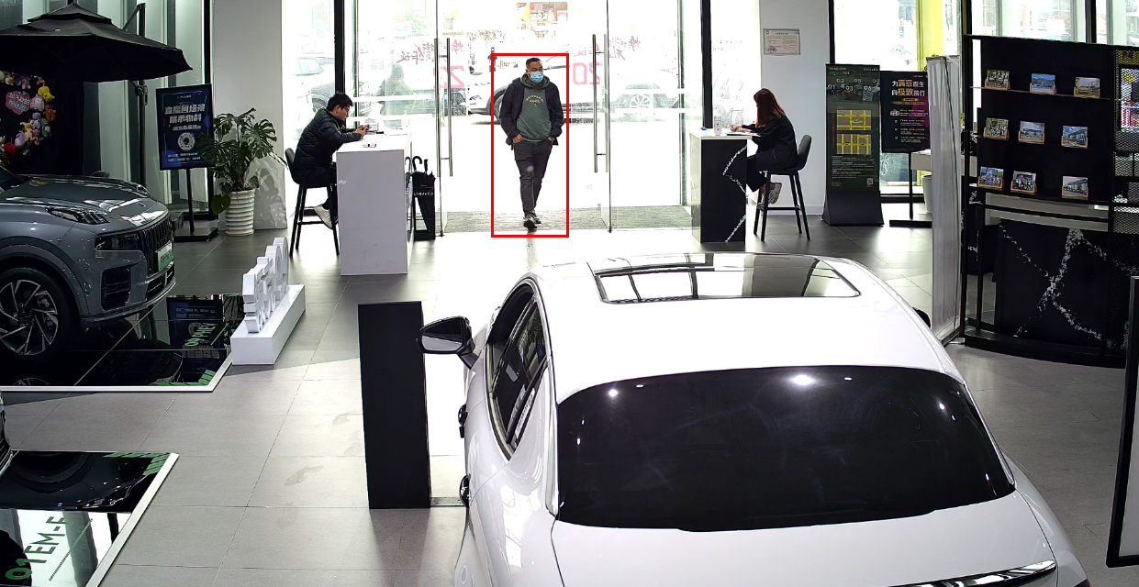
Smart Store Case Study: 4S Shop Customer Flow Statistics
Scenario: 1. The number of customers cannot be counted, and the dashboard data cannot be displayed. 2. It is difficult to distinguish shop assistants from customers, so that it is difficult to analyze customer behaviors. 3. Cloud-based video analysis is costly (costly and time-consuming store upgrade, costly deployment) and the latency is high.
Solution: 1. Huawei provides key AI capabilities with device-cloud synergy. AI tasks are centrally processed on the devices, featuring high responsiveness and efficiency. This reduces in-cloud migration cost. 2. Huawei provides AI-powered video analysis to distinguish shop assistants from customers and count the number of customers. 3. The shop only needs to connect to existing camera video streams for smart store upgrade, reducing the deployment period and costs.

